Slide 1
Economic and Real Estate Market Outlook
February 2022
Lawrence Yun, Ph.D.
Chief Economist
National Association of REALTORS®

Slide 2
Payroll Jobs in Nassau-Suffolk Counties

Slide 3
Payroll Jobs in NYC Metro

Slide 4
Payroll Jobs in Phoenix

Slide 5
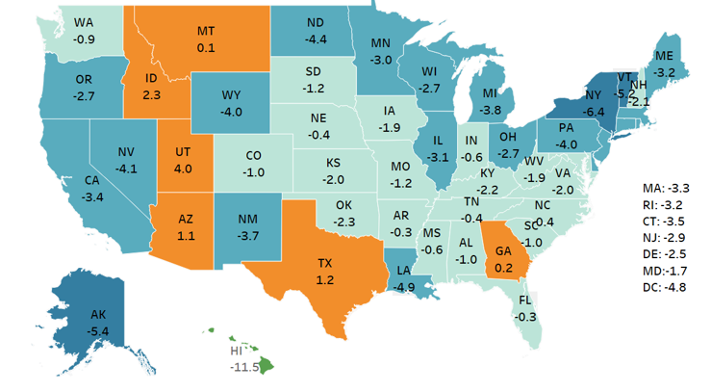
State-by-State Job Growth
from March 2020 to December 2021

Slide 6
Worker Shortage Everywhere except NAR Membership

Slide 7
Consumer Price Inflation at 7.5%

Slide 8
Home Price as Inflation Hedge
Decade | Home Price Average Annual | Consumer Price Average Annual
1970s | 9.9% | 7.1%
1980s | 5.5% | 5.6%
1990s | 4.1% | 3.0%
2000s | 2.3% | 2.6%
2010s | 4.9% | 1.8%
2020 + 2021 | 12% | 3%

Slide 9
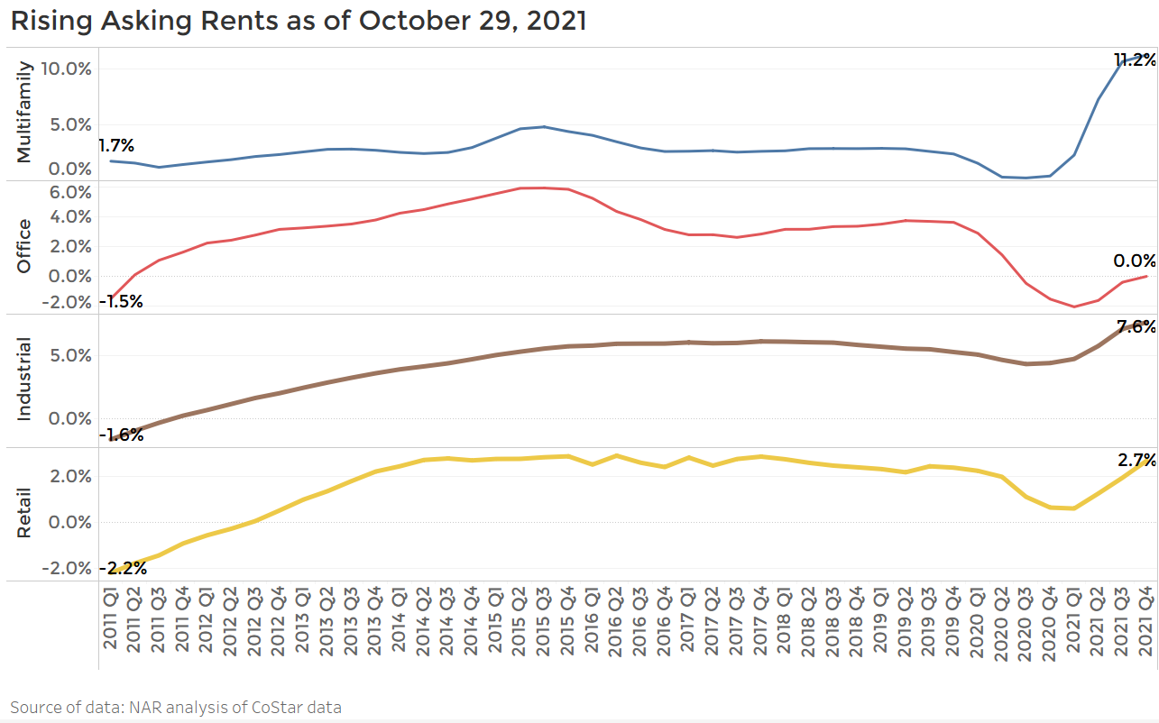
Rent Growth as Hedge against Inflation

Slide 10
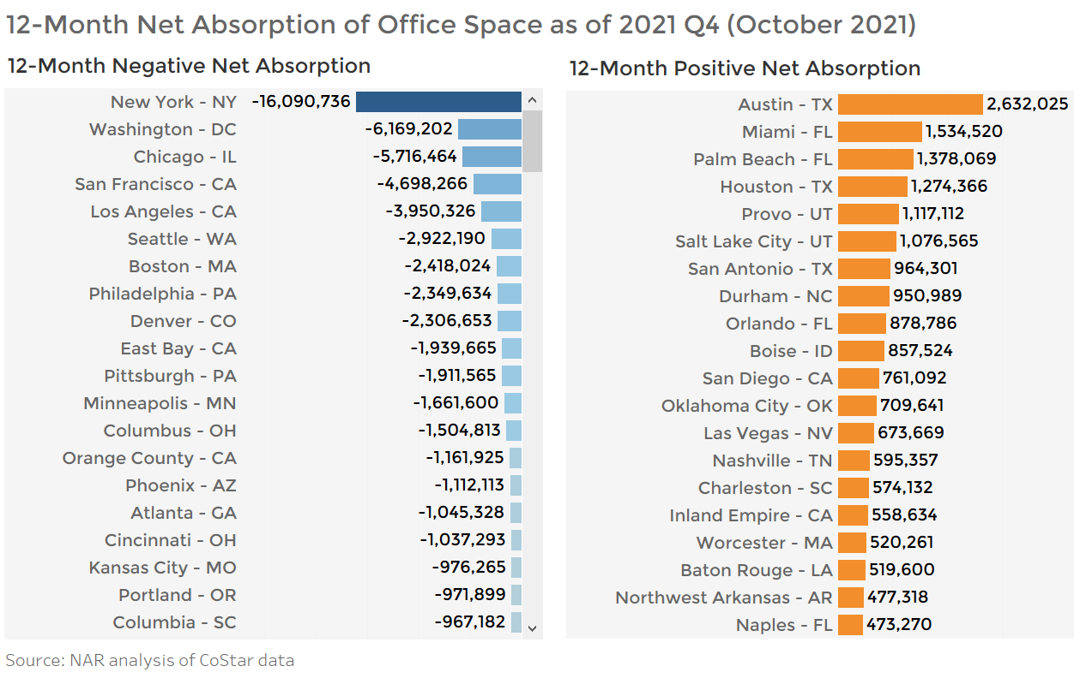
Office Occupancy losers and winners

Slide 11
Existing Home Sales – Recent Months

Slide 12
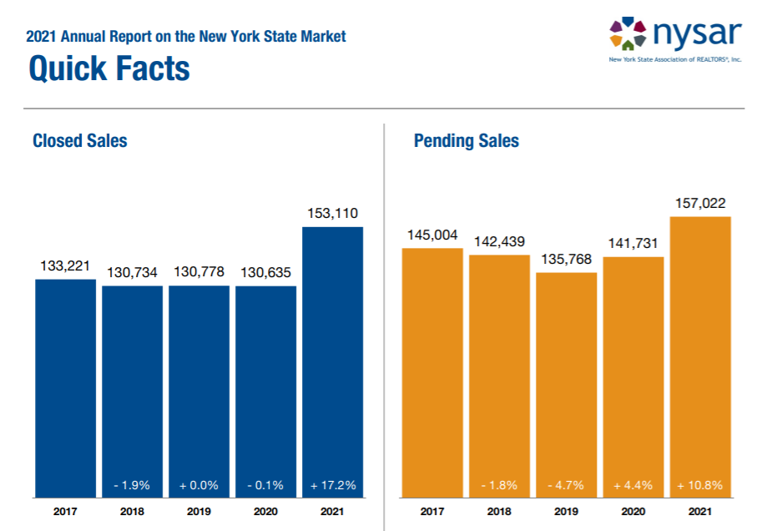
Nassau up 26%
Suffolk up 16%

Slide 13
Median Home Price in Nassau-Suffolk Counties
$ thousands

Slide 14
Median Home Price one-year growth rate
% change from a year ago as of 2021 Q3 from FHFA

Slide 15
Homeownership Rates

Slide 16
Homeownership Rate by Race/Ethnicity
White
Asian
Hispanic
Black

Slide 17
Mortgage Rate Forecast

Slide 18
Low Housing Inventory … will shoot higher in 2022

Slide 19
Single-family Housing Starts
In thousand units

Slide 20
Mortgage Delinquency and Foreclosure Starts

Slide 21
Death Certificates in U.S.
12-month total

Slide 22
National Home Sales Revenue Forecast
Year | Unit Sales | Home Price | Dollar Volume
2015 | +6.3% | +6.8% | +12%
2016 | +3.8% | +5.1% | +9%
2017 | +1.1% | +5.7% | +7%
2018 | -3.1% | +4.9% | +2%
2019 | 0.0% | +4.9% | +5%
2020 | +5.6% | +9.1% | +15%
2021 | +8.5% | +16.9% | +25%
2022 forecast | -3% | +5% | +2%
2023 forecast | +2% | +4% | +6%

Slide 23
Thank You

