Slide 1




How to Successfully Navigate the 2020
Long Island
Real Estate Market
The session will begin promptly at 12 o’clock

Slide 2
How to Successfully Navigate the 2020
Long Island
Real Estate Market

Slide 3

When is the economy going to recover?

Slide 4
Check Mark
Tick
‘W’
“The Flying W”
‘U’
‘V’
Nike Swoosh

Slide 5
L

Slide 6
1. Business Science – How has the economy rebounded from similar slowdowns in the past?
2. Health Science – When will COVID-19 be under control? Will there be another flareup of the virus this fall?
3. Social Science – After businesses are fully operational, how long will it take American consumers to return to normal consumption patterns? (Ex: going to the movies, attending a sporting event, or flying).

Slide 7
Zillow - “During epidemics such as the 1918 influenza or the 2003 SARS outbreaks, economic activity fell sharply during the epidemic but snapped back quickly once the epidemic was over.”
John Burns Consulting - “Historical analysis showed that pandemics are usually V-shaped (sharp recessions that recover quickly enough to provide little damage
to home prices).”
Harvard Business Review – “V-shapes monopolize the empirical landscape of prior shocks, including epidemics such as SARS, the 1968 H3N2 flu, 1958 H2N2 flu, and 1918 Spanish flu.”

Slide 8
Major financial institutions are
calling for a ‘V’ shaped recovery
2020 GDP
0%
-4.8*
-4.8%*
*Q1 GDP Advance Estimate BEA.gov
Quarter 1
Quarter 2
Quarter 3
Quarter 4
Notes:
https://www.goldmansachs.com/insights/pages/gs-research/us-daily-20-mar-2020/report.pdf
https://www.jpmorgan.com/global/research/fallout-from-covid19
https://www.marketwatch.com/story/morgan-stanley-releases-new-forecast-showing-us-economy-may-drop-as-much-as-38-2020-04-03
https://olui2.fs.ml.com/Publish/Content/application/pdf/GWMOL/ME-cio-weekly-letter.pdf
https://www08.wellsfargomedia.com/assets/pdf/commercial/insights/economics/monthly-outlook/forecast-update-20200325.pdf

Slide 9
“Although the uncertainty of the crisis means forecasts of economic activity are more unclear than usual, we expect that most of the economic damage from the virus will be contained to the first half of the year. Going forward, we should see a recovery starting in the second half of 2020.”
Sam Khater
Chief Economist at Freddie Mac
Notes:
http://www.freddiemac.com/fmac-resources/research/pdf/April_2020_Forecast_Press_Release.pdf

Slide 10

Is this going to be 2008 all over again?

Slide 11

Annual Home Price Appreciation
The 6 years leading up
to the housing crash
The last 6 years
Black Knight
Notes:
https://www.blackknightinc.com/black-knights-december-2019-mortgage-monitor-2/

Slide 12
Months Inventory of Homes for Sale
2010
Buyers’
Market
(> 7 Months)
2008
2007
2006
Neutral Market (6-7 Months)
Sellers’
Market
(< 6 Months)
1999
Today
NAR
Notes:
nar.realtor
https://www.nar.realtor/topics/existing-home-sales
https://www.nar.realtor/newsroom/existing-home-sales-jump-6-5-in-february

Slide 13
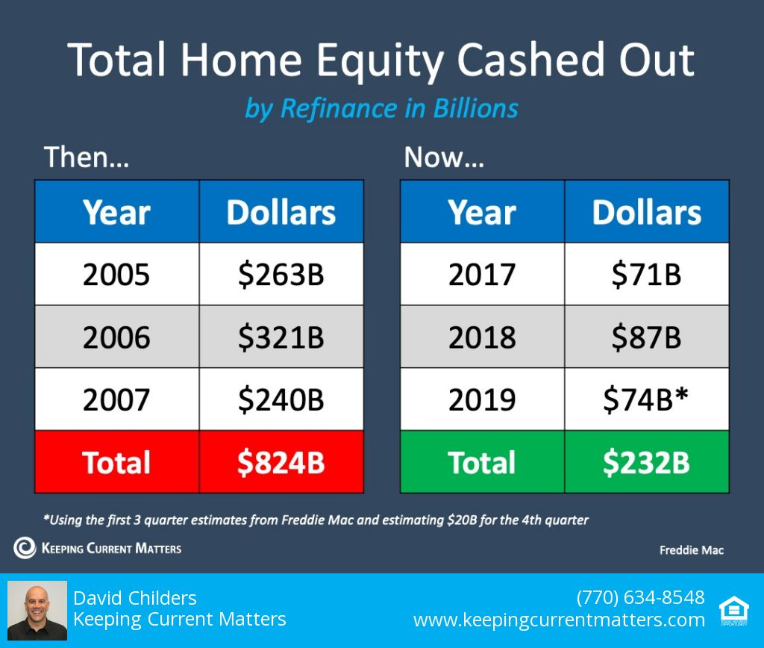

Slide 14
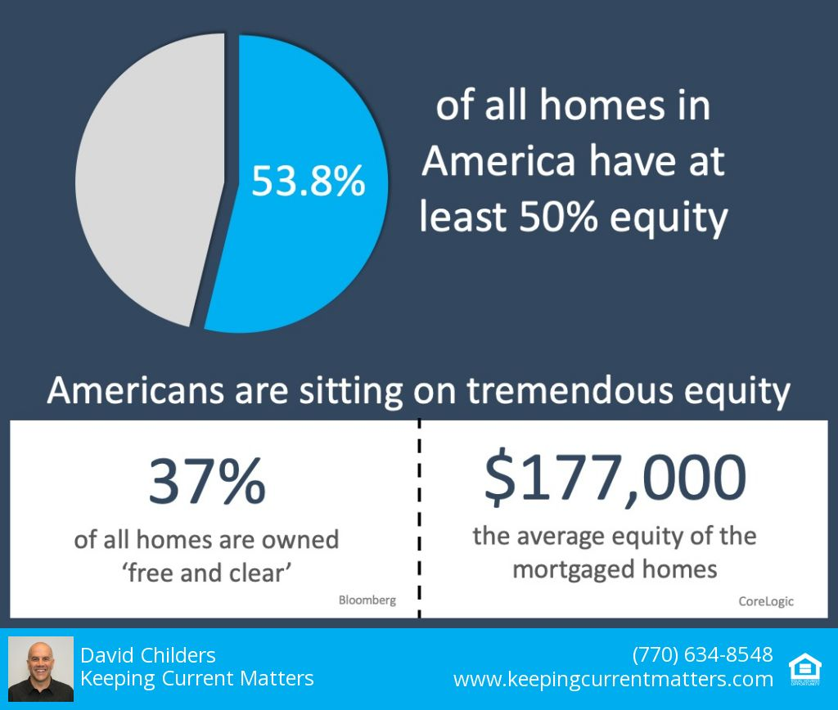

Slide 15


Slide 16
“Many still bear scars from the Great Recession and may expect the housing market to follow a similar trajectory in response to the coronavirus outbreak. But, there are distinct differences that indicate the housing market may follow a much different path. While housing led the recession in 2008-2009, this time it may be poised to bring us out of it.”
Mark Fleming
Chief Economist at First American
Notes:
https://blog.firstam.com/economics/why-the-housing-market-may-weather-coronavirus-impact-better-than-the-great-recession

Slide 17

Recession DOES NOT Equal Housing Crisis

Slide 18
HOME PRICE CHANGE
During Last 5 Recessions
CoreLogic National Home Price Index
Notes:
https://www.corelogic.com/blog/2019/03/housing-recessions-and-recoveries.aspx

Slide 19

What about all the job losses?

Slide 20
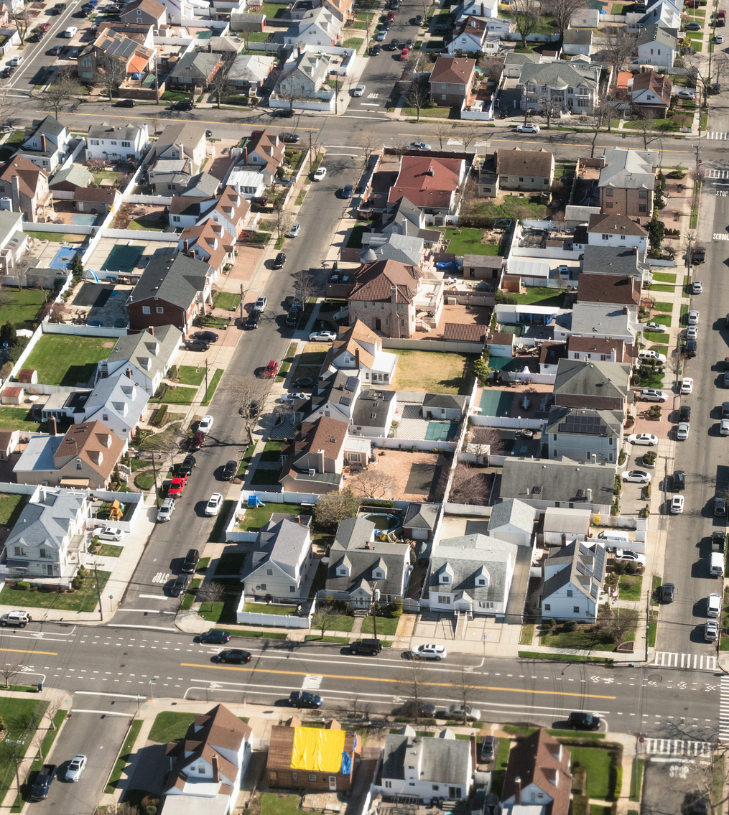
The Biggest
Threat

Slide 21
Impact of COVID-19 to Real Estate Showings in North America
Last 3 weeks
Weekly showings normalized to the first calendar week of January, 7-day moving average.
ShowingTime
Notes:
https://www.showingtime.com/impact-of-coronavirus/

Slide 22
Impact of COVID-19 to Real Estate Showings in New York
National
Weekly showings normalized to the first calendar week of January, 7-day moving average.
New York
ShowingTime
Notes:
https://www.showingtime.com/impact-of-coronavirus/

Slide 23
“We note that inventory as a percent of households sits at the lowest level ever.”
‘Z’ Report
Notes:
www.zelmanandassociates.com (subscription required)

Slide 24
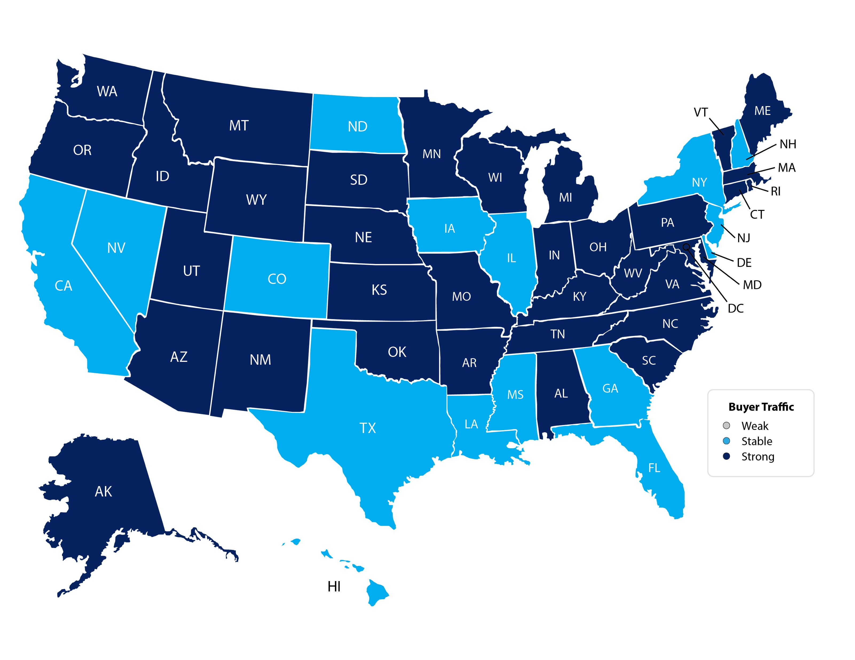
March Buyer Traffic Index
NAR
Notes:
https://www.nar.realtor/research-and-statistics/research-reports/realtors-confidence-index

Slide 25
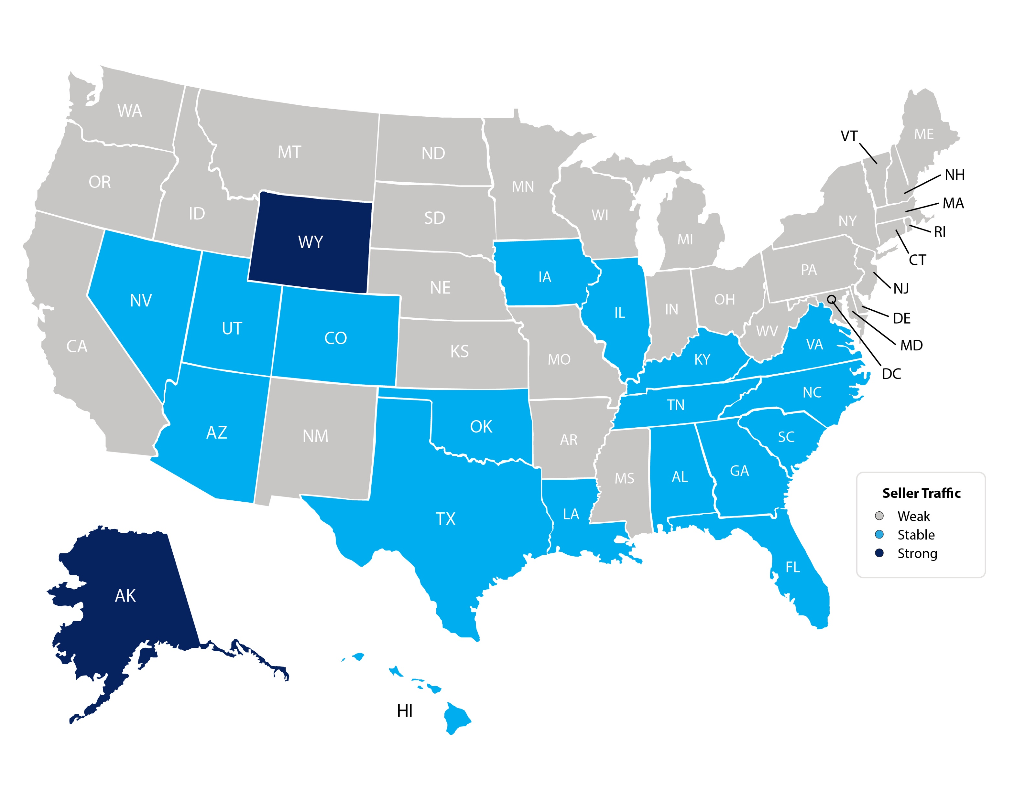
February Seller Traffic Index
NAR
Notes:
https://www.nar.realtor/sites/default/files/documents/2020-02-realtors-confidence-index-03-20-2020.pdf

Slide 26
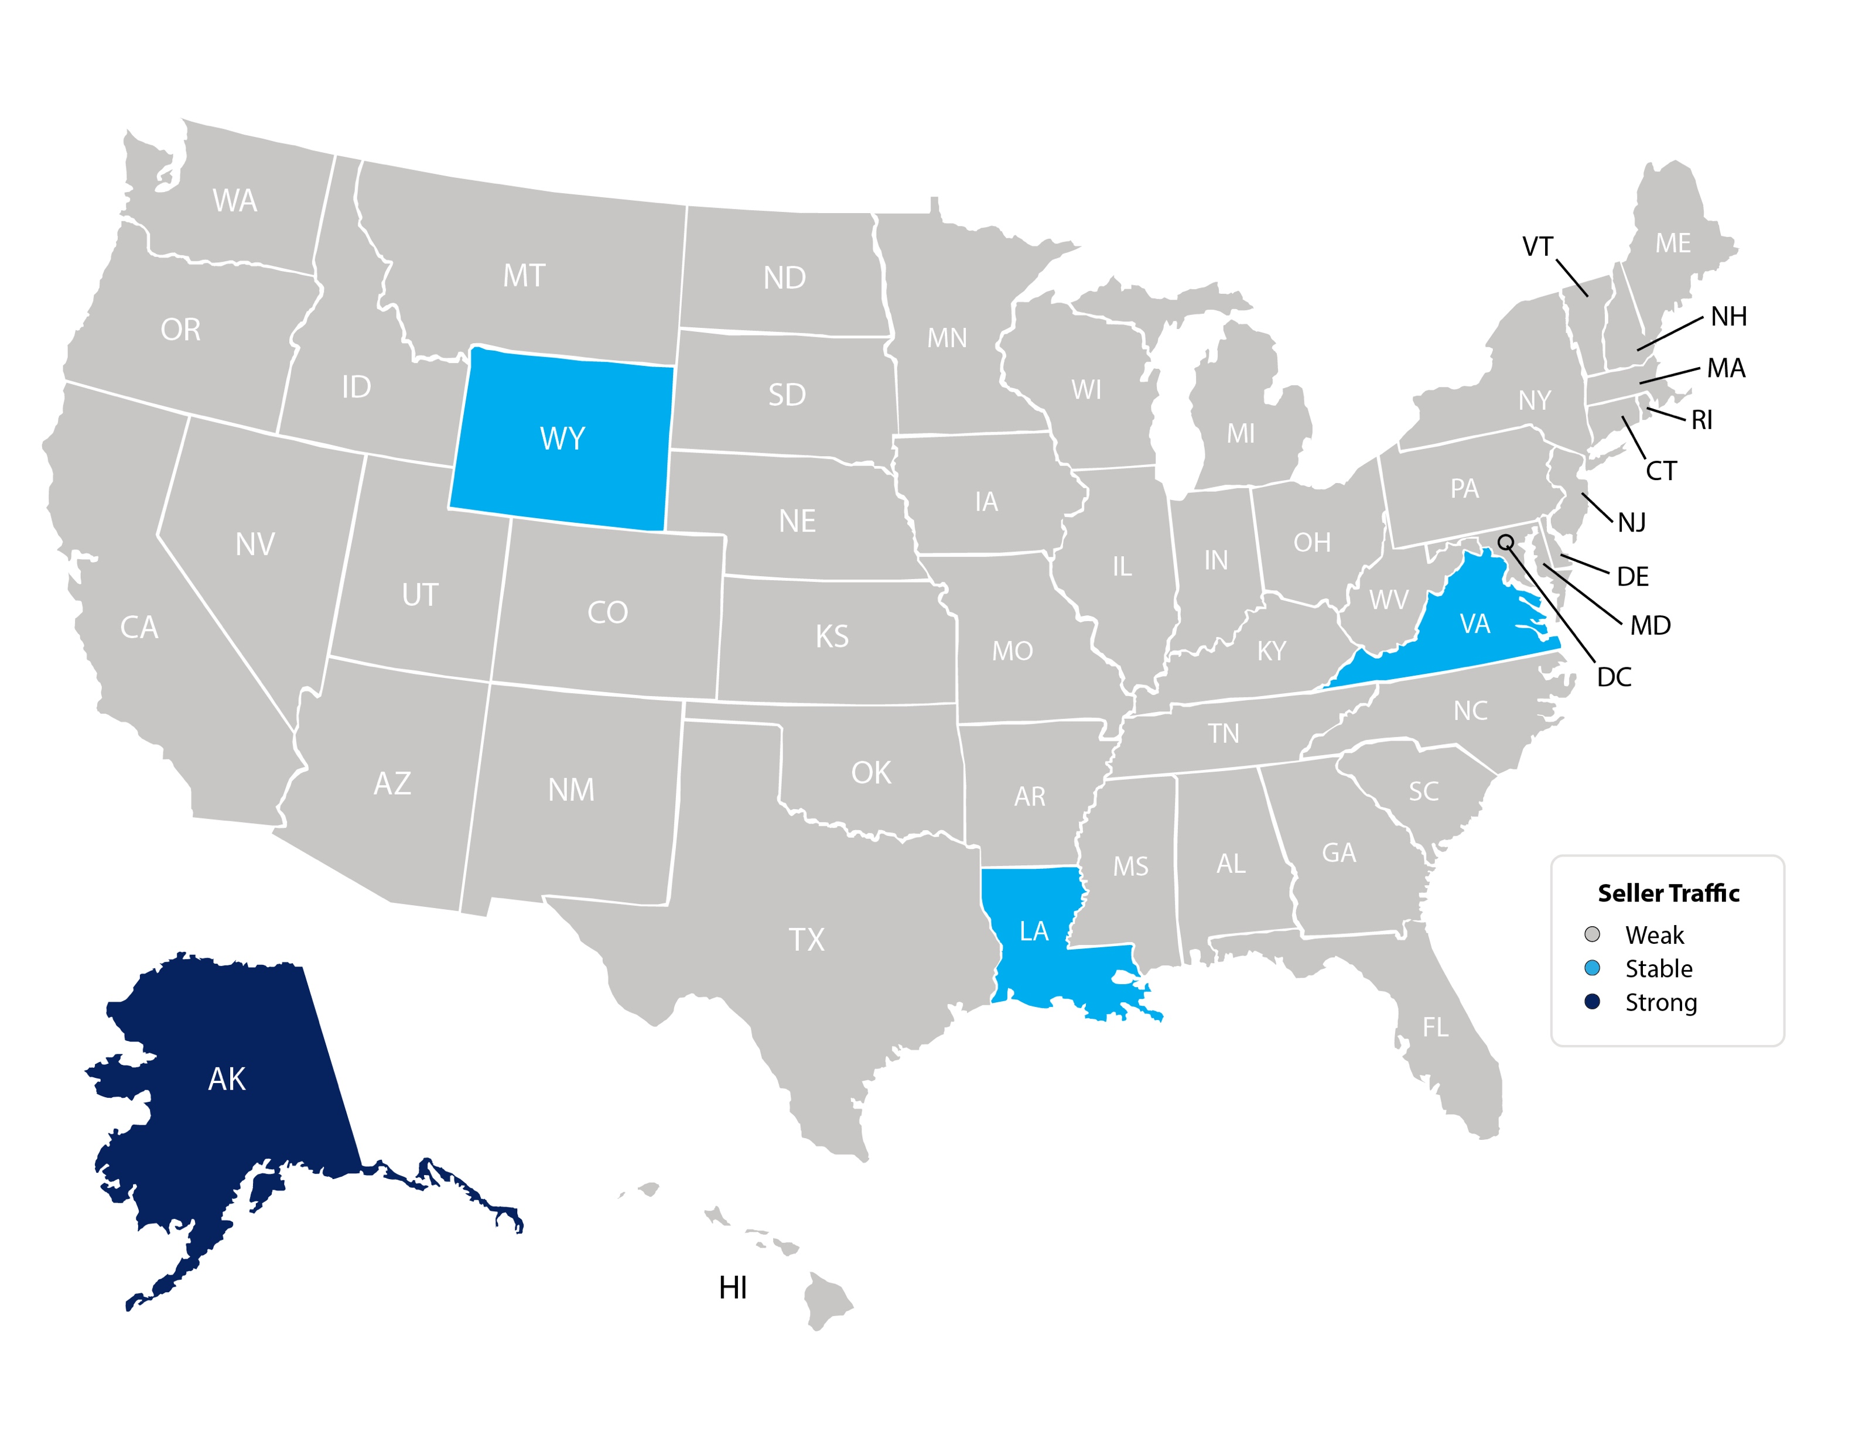
March Seller Traffic Index
NAR
Notes:
https://www.nar.realtor/research-and-statistics/research-reports/realtors-confidence-index

Slide 27

What do you need to do right now?

Slide 28
Calm down.
Sit down.
Think.
Plan.
Act.

Slide 29

1. Prospect for Leads
2. Nurture those Leads
3. Close those Leads

Slide 30
#1
Make your message
simple and effective
#2
Remain hyper-current on all housing info
#3
Mix micro data with your macro data
#4
Use VIDEOS on Social Media & ZOOM Meetings!

Slide 31
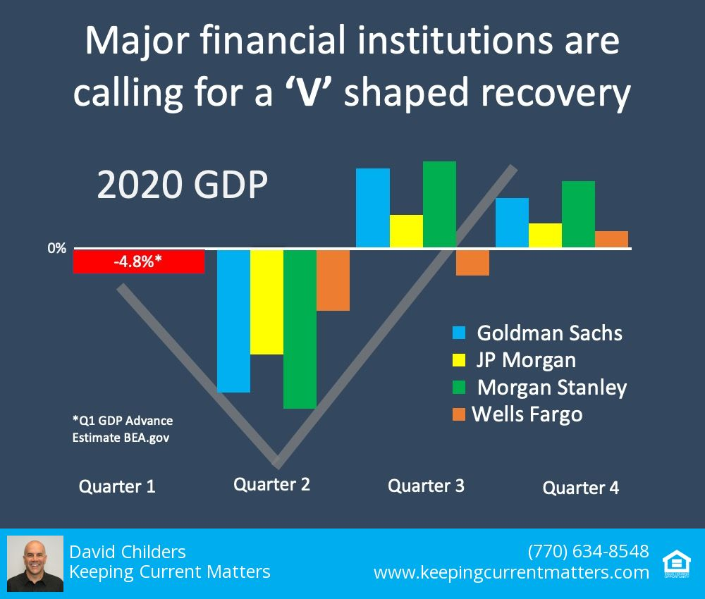

Slide 32
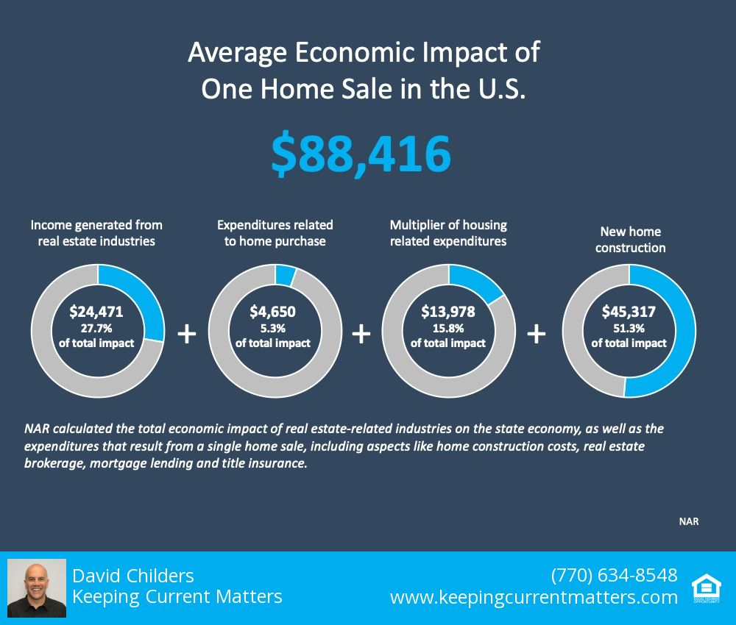

Slide 33
TryKCM.com

