Slide 1



Leadership in
Times of Turmoil
The session will begin promptly at 12 o’clock

Slide 2
Leadership in
Times of Turmoil

Slide 3
LIBOR’s COVID-19 Hub
lirealtor.com/covid

Slide 4
“No one can take the ultimate weight of decision making off your shoulders.
But the more you know about how things really are, the lighter the burden will be.”
- John Burns’ Dad

Slide 5
1.) Why do we believe the downturn will reverse course quickly?
2.) What research and data are we seeing that causes our optimism?
3.) What are the three activities each agent must embrace to survive this market?
4.) How do we optimize the recruiting opportunities this chaos is delivering?
5.) What leadership traits must you exhibit in times of turmoil?

Slide 6
1.) Why do we believe the downturn will reverse course quickly?
2.) What research and data are we seeing that causes our optimism?
3.) What are the three activities each agent must embrace to survive this market?
4.) How do we optimize the recruiting opportunities this chaos is delivering?
5.) What leadership traits must you exhibit in times of turmoil?

Slide 7
Major Financial Institutions are
Calling for a ‘V’ Type Recovery
0% GDP Growth
2020 GDP
As of 4/1/2020
Subject to Change
Quarter 1
Quarter 2
Quarter 3
Notes:
https://www.calculatedriskblog.com/2020/03/the-economic-outlook.html
https://markets.businessinsider.com/news/stocks/us-recession-coronavirus-gdp-plunge-2q-forecast-economy-morgan-stanley-2020-3-1029023137
https://www.foxbusiness.com/markets/coronavirus-gdp-impact-bigger-than-financial-crisis-j-p-morgan

Slide 8
“It’s worth looking back at history to place the potential impact path of Covid-19 empirically. In fact, V-shapes monopolize the empirical landscape of prior shocks, including epidemics such as SARS, the 1968 H3N2 (“Hong Kong”) flu, 1958 H2N2 (“Asian”) flu, and 1918 Spanish flu.”
Harvard Business Review
Notes:
https://hbr.org/2020/03/what-coronavirus-could-mean-for-the-global-economy

Slide 9
“Historical analysis showed us that pandemics are usually V-shaped (sharp recessions that recover quickly enough
to provide little damage to home prices),
and some very cutting-edge search engine analysis by our Information Management team showed the current slowdown
is playing out similarly thus far.”
John Burns Consulting
Notes:
https://www.realestateconsulting.com/march-19-2020-housing-survival-to-date/

Slide 10
“Supported by our analysis of home price dynamics through cycles and other periods of economic and housing disruption, we expect home price appreciation to decelerate from current levels in 2020, though easily remain in positive territory year over year given the beneficial factors of record-low inventories & a historically-low interest rate environment.”
Ivy Zelman
The ‘Z’ Report
Notes:
www.zelmanandassociates.com (subscription required)
Overall, we now expect 2020-21 year-end home price appreciation of 3.0% and 4.2%, respectively, versus our prior estimates of 4.7% and 3.8%. We are also introducing our 2022 year-end forecast of 4.6%.”

Slide 11
Overall, we now expect 2020-21 year-end home price appreciation of 3.% and 4.2%… We are also introducing our 2022 year-end forecast of 4.6%.”
Home Appreciation Adjustments
as a Result of the Pandemic
Ivy Zelman
The ‘Z’ Report
N/A
‘Z’ Report
Notes:
www.zelmanandassociates.com (subscription required)
Overall, we now expect 2020-21 year-end home price appreciation of 3.0% and 4.2%, respectively, versus our prior estimates of 4.7% and 3.8%. We are also introducing our 2022 year-end forecast of 4.6%.”

Slide 12
1.) Why do we believe the downturn will reverse course quickly?
2.) What research and data are we seeing that causes our optimism?
3.) What are the three activities each agent must embrace to survive this market?
4.) How do we optimize the recruiting opportunities this chaos is delivering?
5.) What leadership traits must you exhibit in times of turmoil?

Slide 13
Annual Home Price Appreciation
The 6 years leading up
to the housing crash
The last 6 years
Black Knight
Notes:
https://www.blackknightinc.com/black-knights-december-2019-mortgage-monitor-2/

Slide 14
Housing Bubble
868.7
Historic Data for the MORTGAGE CREDIT AVAILABILITY INDEX
Today
152.1
MBA
Notes:
https://www.mba.org/news-research-and-resources/newsroom
https://www.mba.org/news-research-and-resources/research-and-economics/single-family-research/mortgage-credit-availability-index

Slide 15
Months Inventory of Homes for Sale
2010
Buyers’
Market
(> 7 Months)
2008
2007
2006
Neutral Market (6-7 Months)
Sellers’
Market
(< 6 Months)
Today
NAR
Notes:
nar.realtor
https://www.nar.realtor/topics/existing-home-sales
https://www.nar.realtor/newsroom/existing-home-sales-jump-6-5-in-february

Slide 16
Total Home Equity Cashed Out
by Refinance in Billions
Then…
Now…
Year | Dollars
2005 | $263B
2006 | $321B
2007 | $240B
Total | $824B
Year | Dollars
2017 | $71B
2018 | $87B
2019 | $74B*
Total | $232B
*Using the first 3 quarter estimates from Freddie Mac and estimating $20B for the 4th quarter
Freddie Mac
Notes:
http://www.freddiemac.com/research/datasets/refinance-stats/index.page

Slide 17
of all homes in America have at least 50% equity
53.8%
Americans are sitting on tremendous equity
37%
of all homes are owned
‘free and clear’
26.7%
of the mortgaged homes
have at least 50% equity
Bloomberg
ATTOM Data
Notes:
https://www.bloomberg.com/news/articles/2019-07-17/close-to-40-of-u-s-homes-are-free-and-clear-of-a-mortgage
https://www.attomdata.com/news/market-trends/home-sales-prices/attom-data-solutions-2019-year-end-home-equity-and-underwater-report/
37% + 16.8% (26.7% of the remaining 63% of homes with a mortgage)

Slide 18
“Many still bear scars from the Great Recession and may expect the housing market to follow a similar trajectory in response to the coronavirus outbreak. But, there are distinct differences that indicate the housing market may follow a much different path. While housing led the recession in 2008-2009, this time it may be poised to bring us out of it.”
Mark Fleming
Chief Economist at First American
Notes:
https://blog.firstam.com/economics/why-the-housing-market-may-weather-coronavirus-impact-better-than-the-great-recession

Slide 19

Recession DOES NOT
Equal Housing Crisis

Slide 20
“With the exception of two recessions, the Great Recession from 2007-2009, & the Gulf War recession from 1990-1991, no other recessions have impacted the U.S housing market, according to Freddie Mac Home Price Index data collected from 1975 to 2018.”
Doug Brien
Chief Economist with NAHB
Notes:
https://www.nreionline.com/investment/investors-turn-safe-haven-us-real-estate-wake-coronavirus

Slide 21
1991
2008
HOME PRICE CHANGE
During Last 5 Recessions
CoreLogic National Home Price Index
Notes:
https://www.corelogic.com/blog/2019/03/housing-recessions-and-recoveries.aspx

Slide 22
Breakdown of U.S. Bureau of Labor Statistics 4/3/2020 Unemployment Report Covering Up Until 3/14
Accommodation industry
Other
Retail Trade (stores)
Temporary help services
Food services and drinking places
(servers and bartenders)
Child Day Care workers
Health care office workers
Construction workers
Notes:
https://www.bls.gov/news.release/empsit.nr0.htm

Slide 23
“My results do suggest that, in the absence of the panic, the declines in employment, consumption and output in the early stages of the Great Recession would have been significantly less severe.”
Ben Bernanke
Notes:
https://www.brookings.edu/bpea-articles/the-real-effects-of-the-financial-crisis/

Slide 24
1.) Why do we believe the downturn will reverse course quickly?
2.) What research and data are we seeing that causes our optimism?
3.) What are the three activities each agent must embrace to survive this market?
4.) How do we optimize the recruiting opportunities this chaos is delivering?
5.) What leadership traits must you exhibit in times of turmoil?

Slide 25

CONFUSION

Slide 26

Confusion Leads to Indecision

Slide 27
1. Prospect for Leads
2. Nurture those Leads
3. Close those Leads

Slide 28
1. Prospect for Leads
2. Nurture those Leads
3. Close those Leads

Slide 29
“How can you differentiate yourself during a pandemic?
By creating educational content that keeps your clients and prospects informed during these dark times.”
Housing Wire

Slide 30
1.) Why do we believe the downturn will reverse course quickly?
2.) What research and data are we seeing that causes our optimism?
3.) What are the three activities each agent must embrace to survive this market?
4.) How do we optimize the recruiting opportunities this chaos is delivering?
5.) What leadership traits must you exhibit in times of turmoil?

Slide 31
I have never recruited an agent.
You shouldn’t either.

Slide 32

Rescue Them

Slide 33
1.) Why do we believe the downturn will reverse course quickly?
2.) What research and data are we seeing that causes our optimism?
3.) What are the three activities each agent must embrace to survive this market?
4.) How do we optimize the recruiting opportunities this chaos is delivering?
5.) What leadership traits must you exhibit in times of turmoil?

Slide 34
“A leader must be the person people come to in times of crisis.
When they get there, they must never see you hungry, cold, afraid or tired.”
- Colin Powell

Slide 35
“The first responsibility
of the leader is to
define reality.”
- Max Depree in his book, ‘Leadership is an Art’

Slide 36

Make a 90 Day Commitment
…and then Set 30 Day Plans

Slide 37

When Arthur Guinness decided in 1759 to open a brewery, he signed a lease for a four-acre site in downtown Dublin. The terms?

Slide 38
When Arthur Guinness decided in 1759 to open a brewery, he signed a lease for a four-acre site in downtown Dublin. The terms?
Forty-five pounds a year for
nine thousand years.

Slide 39
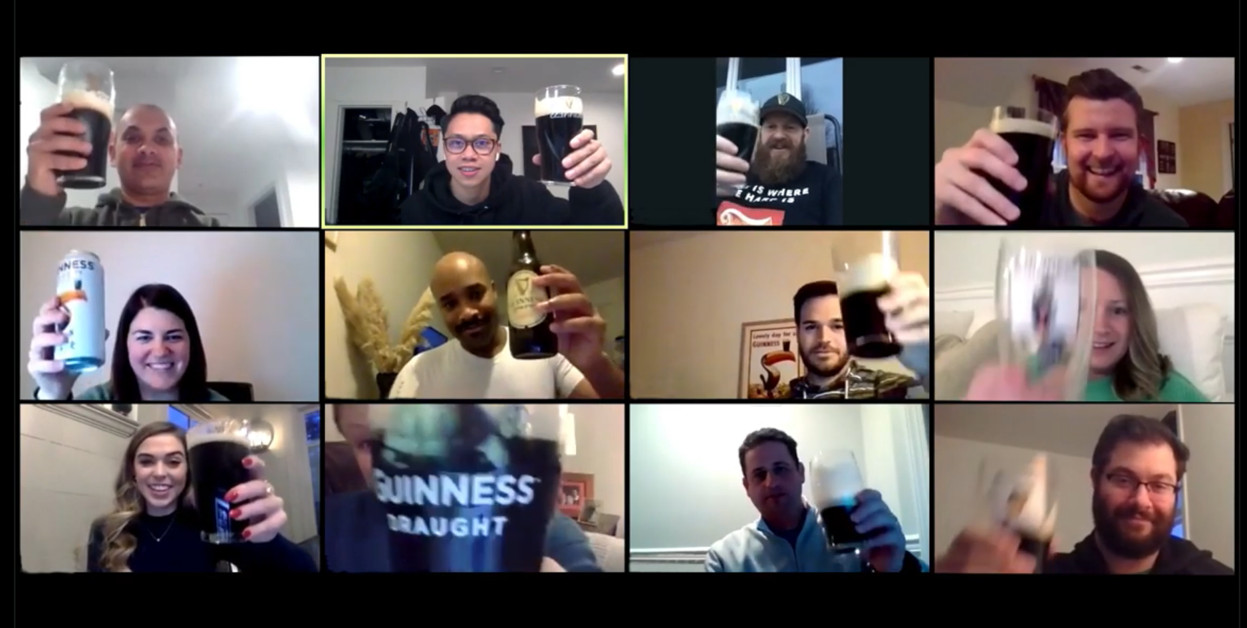
A Message From Guinness: We Will Toast Again
https://www.youtube.com/watch?v=CJOBfyhMsek

